Slide 1



Ballari Institute of Technology & Management, Ballari
Department of Computer Science & Engineering
Project Work Phase-2
Presentation on
Non-Invasive Blood Group Detection Using Fingerprints
Under the Guidance of Project Associates
Dr C K Srinivas USN Name
3BR22CS120 Poorvi H
3BR22CS122 Pragna A
3BR22CS136 Rajeshwari
3BR23CS402 B Fouziya

Slide 2
CONTENTS
Abstract
Vision, Mission ,Objectives and Problem Statement
Introduction
Literature Survey
Existing System and Proposed System
Feasibility Study
Project Management and Cost Estimation
Hardware and Software Requirements
System Design
Implementation
Results and Discussion
Conclusion and Future Scope
References
Publication Status

Slide 3
Abstract
Non-Invasive blood group identification has gained significant research interest due to the limitations of traditional serological methods that require physical blood samples and laboratory infrastructure. This work proposes a fingerprint-based blood group detection system that utilizes image processing and machine learning techniques to classify blood groups from fingerprint images. Distinctive fingerprint ridge characteristics are extracted through preprocessing, skeletonization, and texture analysis, and subsequently classified using supervised learning models. The proposed approach offers a rapid, user-friendly, and non-invasive alternative for blood group identification.

Slide 4
Vision and Mission
  Vision
To revolutionize blood group identification through non-invasive,making rapid and accessible diagnostics a reality for every individual, everywhere.
  Mission
To revolutionize blood group identification by introducing a fast, non-invasive, and technology-driven solution using fingerprints.
To develop an accurate and reliable blood group prediction system using fingerprint image processing and machine learning techniques..
To make healthcare more accessible by providing a low-cost and user-friendly alternative to traditional laboratory-based blood testing.

Slide 5
Objectives and Problem Statement
Objectives
To design a non-invasive system that predicts an individual’s blood group using fingerprint images instead of traditional blood samples.
To extract fingerprint features using image processing techniques and apply machine learning models for accurate blood group prediction.
To provide a fast, painless, and user-friendly alternative to conventional blood testing methods.
To develop a scalable model that can be integrated into healthcare diagnostics, biometric identification systems, and blood donation platforms.
Problem Statement
To design and develop a non-invasive, fast blood group identification system using fingerprint images and a Machine learning strategy.

Slide 6
Introduction
The project “Non-Invasive Blood Group Detection Using Fingerprint” proposes an easy and painless method to identify a person’s blood group without traditional blood sampling. Conventional methods are invasive, time-consuming, and costly. This system uses fingerprint images, which contain unique ridge patterns, to extract features such as ridge density and texture. Machine learning algorithms like Random Forest are then used to predict the blood group. The approach is fast, cost-effective, and user-friendly, with potential applications in healthcare systems, blood donation management, and digital medical records..

Slide 7
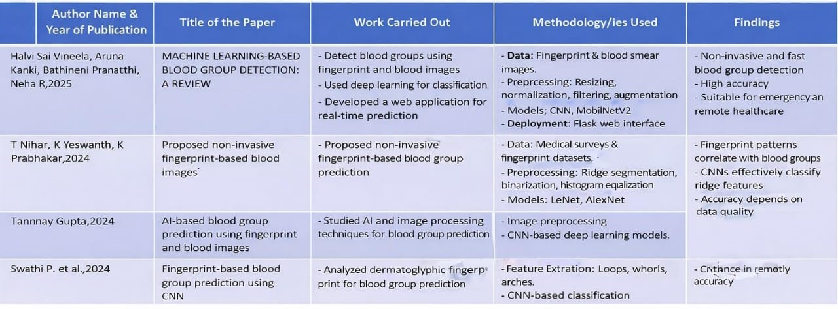
Literature Survey

Slide 8
Existing and Proposed system
Aspect | Existing System | Proposed system
Input Data | Uses multiple inputs like fingerprints with blood smear or blood images. | Uses only fingerprint images
Invasiveness | Partially invasive | Fully non-invasive
Model Type | Conventional CNNs, ML, or hybrid models | Random forest or SVM models
Scalability | Limited scalability | Designed for better scalability
Pre-processing | Basic pre-processing techniques | Enhanced preprocessing for better ridge clarity
Speed | Low | High

Slide 9
Feasibility Study
Technical Feasibility
The system uses commonly available technologies like Python, machine learning, and OpenCV, making it easy to develop and deploy.
Fingerprint image processing with preprocessing and feature extraction enables blood group prediction without invasive procedures.
2. Operational Feasibility
The system is simple and user-friendly, requiring minimal training to capture a fingerprint and get instant results.
Its non-invasive and portable nature allows effective use in clinics, emergencies, and rural or resource-limited areas.

Slide 10
Project Management
1.Planning Phase:
Define project objectives, scope, and deliverables.
Gather requirements for dataset collection, fingerprint preprocessing, and Random forest or SVM selection.
Create a project schedule and divide tasks among team members.
2.Execution & Monitoring Phase:
Perform data preparation, model development, training, and testing.
Conduct regular progress reviews to track milestones and performance.
.

Slide 11
Project Management
3.Quality & Documentation:
Ensure the system meets accuracy, usability, and healthcare standards.
Maintain proper documentation and result analysis.
4.Final Phase:
Plan deployment and prepare final reports.
Evaluate overall system performance for scalability and real-world use.

Slide 12
Cost Estimation
COCOMO Cost Estimation:
The Basic COCOMO (Constructive Cost Model) is used to estimate the effort, development time, team size, and cost of a software project based on its size measured in KLOC (Thousands of Lines of Code).
Our project, Non-Invasive Blood Group Detection Using Fingerprint, is a research-oriented web-based application with moderate algorithmic logic and a flexible development environment. Since the system is developed using standard tools, has manageable complexity, and does not involve strict real-time constraints, it is classified under the Organic project category.

Slide 13
Cost Estimation
COCOMO Equations Used:
Effort (E) = a × (KLOC)ᵇ (measured in Person-Months)
Development Time (T) = c × (E)ᵈ (measured in Months)
Team Size = Effort / Development Time
Total Cost = Effort × Cost per Person-Month
Project Type: Organic
Project Size: ~7.8 KLOC
Development Time: ~5–6 months
Team Size: 4 members
Cost per Person-Month: ₹350 (academic assumption)
Estimated Total Cost: ₹7,280 (≈ ₹7,500)

Slide 14
Software and Hardware Requirements
Software Requirements:
    Computer/Laptop – Minimum Intel i5 processor, 8 GB RAM, 256 GB SSD.
    RAM – 8 GB (minimum)
    Fingerprint Image Source – digital fingerprint image dataset
    Display – Standard monitor for visualization and report generation
Hardware Requirements:
    Operating System – Windows 10/11, Ubuntu, or macOS
    Programming Language – Python
    Machine Learning Framework – scikit-learn
    Image Processing Libraries – OpenCV, scikit-image
    Data Handling Libraries – NumPy
    Web Framework – Streamlit
    IDE / Editor –VS Code

Slide 15
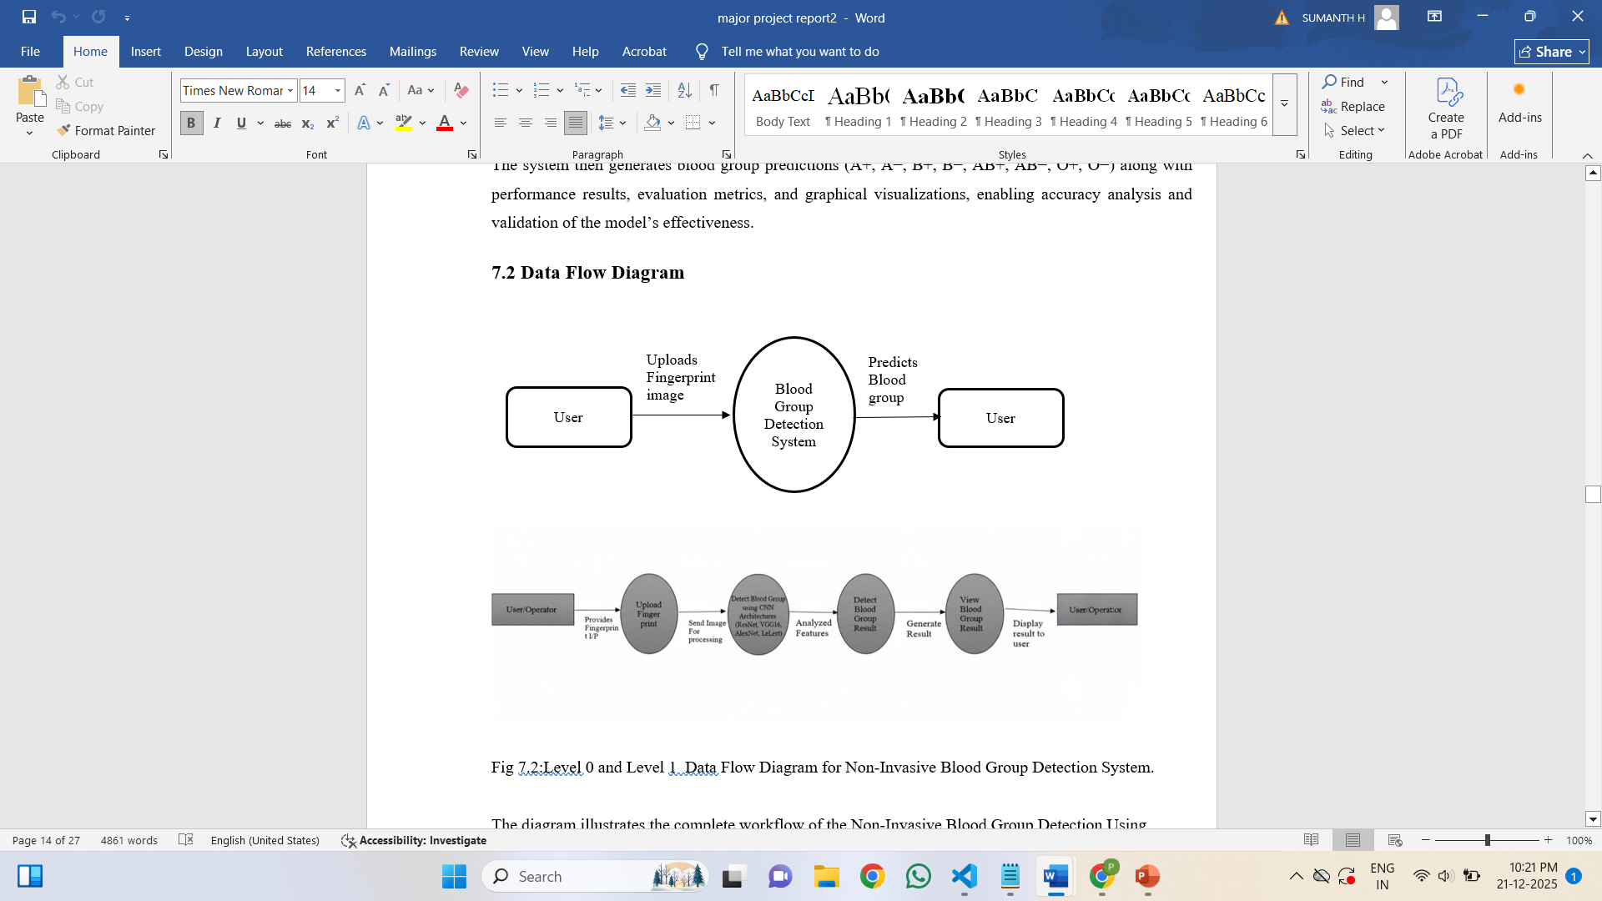
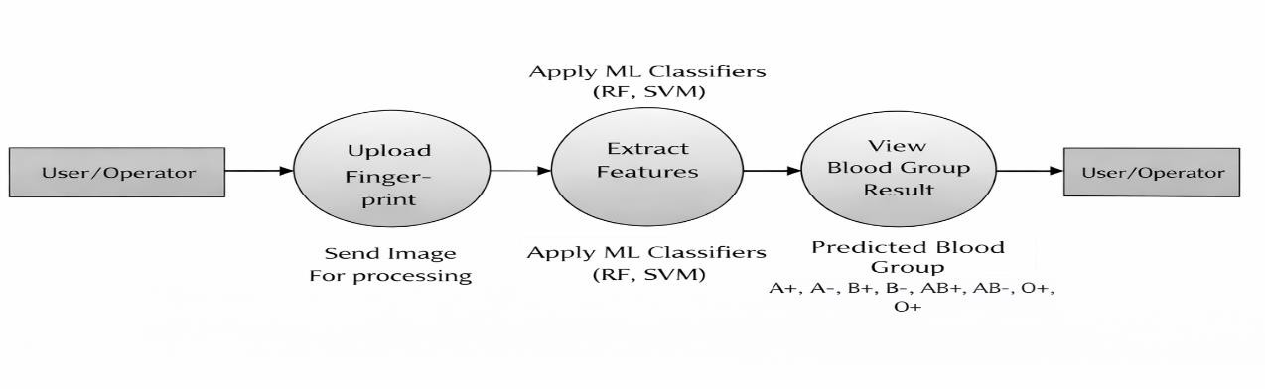
System Design
Data Flow Diagram
Level-0 & Level-1

Slide 16
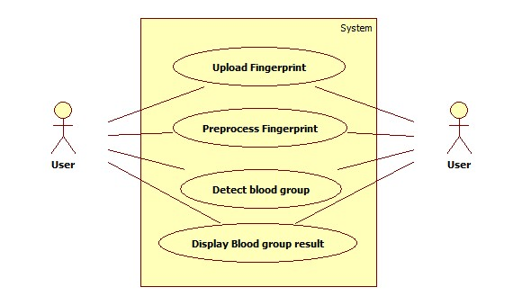
System Design
2. Use Case Diagram

Slide 17
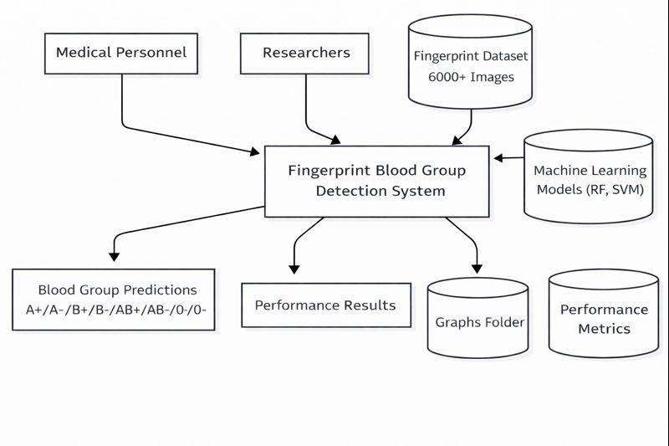
System Design
Context Diagram

Slide 18
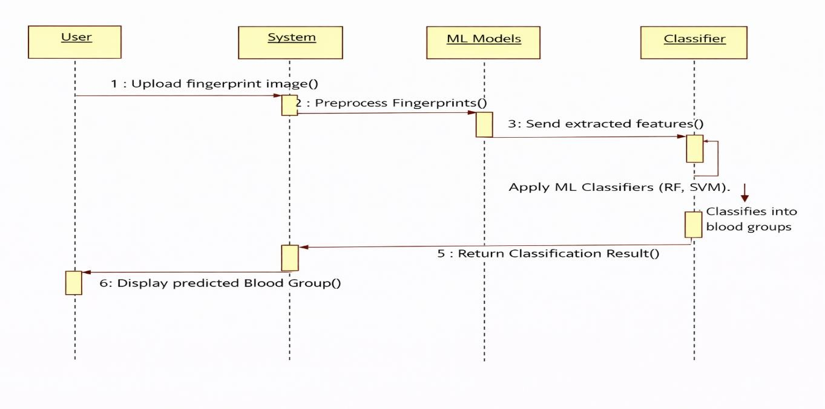
System Design
Sequence Diagram

Slide 19
Implementation
1. Image Acquisition Module
Captures fingerprint images from users.
Ensures consistent lighting, proper finger placement, and good ridge clarity.
Provides the raw input required for preprocessing and model training.
2.Preprocessing Module
Resizes all fingerprint images to a standard dimension suitable for random forest models.
Applies noise reduction filters (Gaussian/Median) to remove distortions.
Enhances contrast to improve ridge and valley visibility.
Performs normalization to standardize pixel ranges.
Includes data augmentation like rotation, flipping, and scaling to increase dataset variety and prevent overfitting.

Slide 20
Implementation
3.Feature Extraction & Classification Module
Uses ML learning models such as Random forest to automatically extract deep fingerprint features.
Learns ridge flow, ridge texture, and other distinguishing fingerprint characteristics.
Trains the model using labeled fingerprint data across all blood groups (A, B, O, AB, Rh+/).
The final classification layer predicts the blood group based on learned patterns.
4. Model Training & Validation Module
This module is responsible for training and evaluating the random forest models for blood group prediction.
The preprocessed fingerprint dataset is divided into training, validation, and testing sets.

Slide 21
Implementation
5. Blood Group Prediction Module
In this module, the trained random forest model is used to predict the blood group from a new fingerprint image.
When a user uploads a fingerprint, the system preprocesses it and passes it to the trained model. The model analyzes extracted features and predicts the most probable blood group (A, B, AB, O with Rh factor).
6. User Interface Module
The user interface module provides a simple and user-friendly platform for interaction.
It allows users to upload their fingerprint image through a graphical interface and initiate the detection process using a single button.

Slide 22
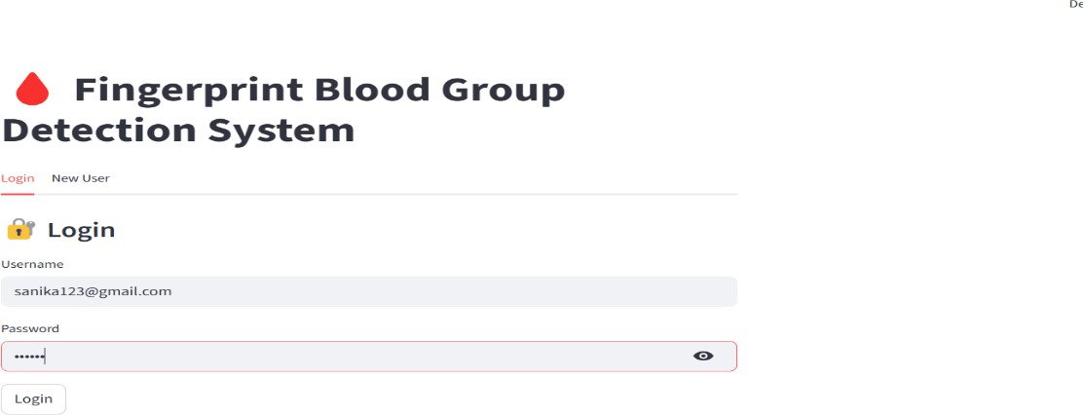
Results and Discussion
The proposed Non-Invasive Blood Group Detection System was implemented and tested using
fingerprint images and machine learning techniques. The system workflow includes user authentication, patient data entry, fingerprint image upload, preprocessing, feature extraction, blood group prediction, and report generation. Each stage of the system was evaluated to analyze its performance and reliability.

Slide 23
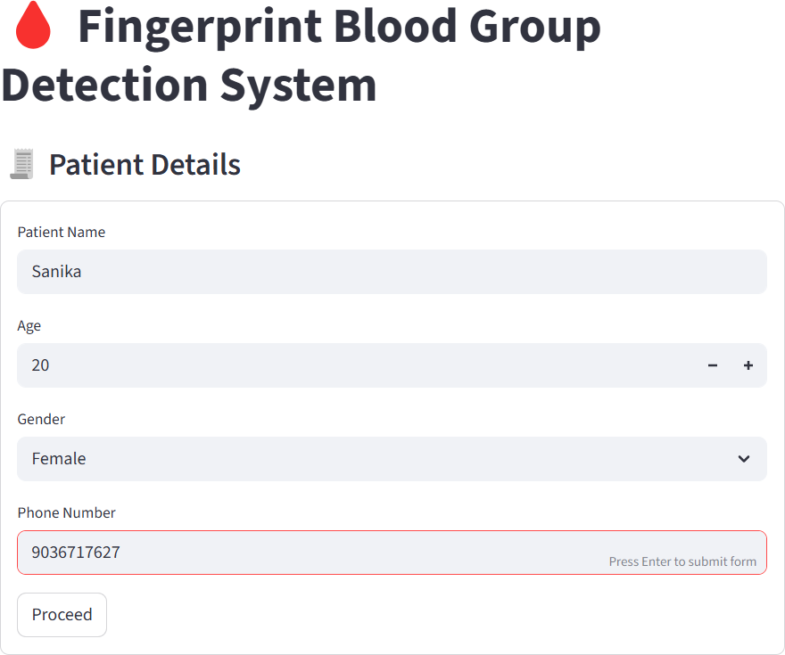
Results and Discussion

Slide 24
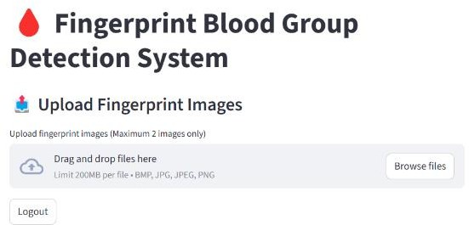
Results and Discussion

Slide 25
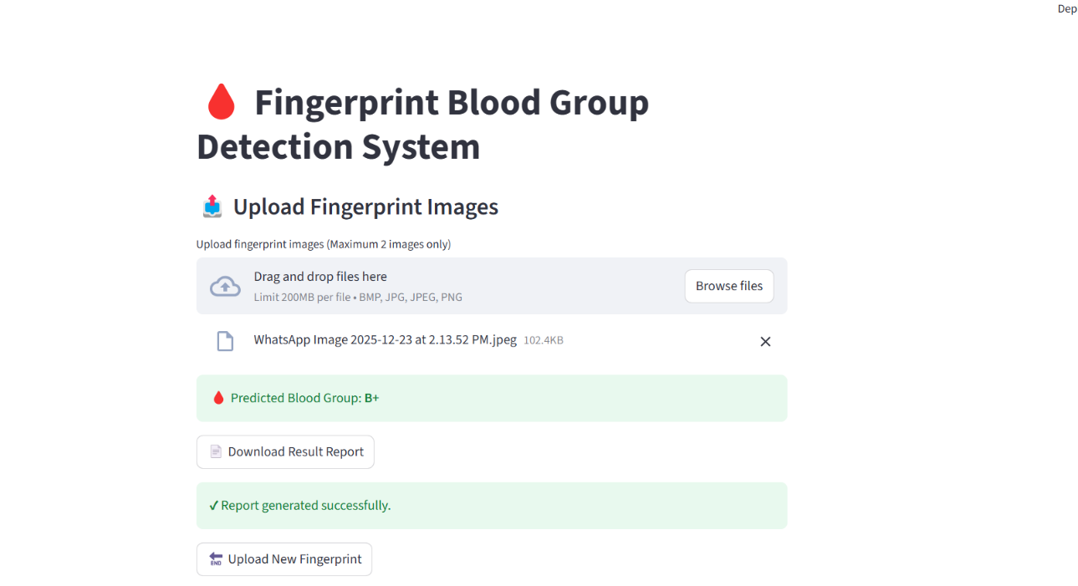

Slide 26
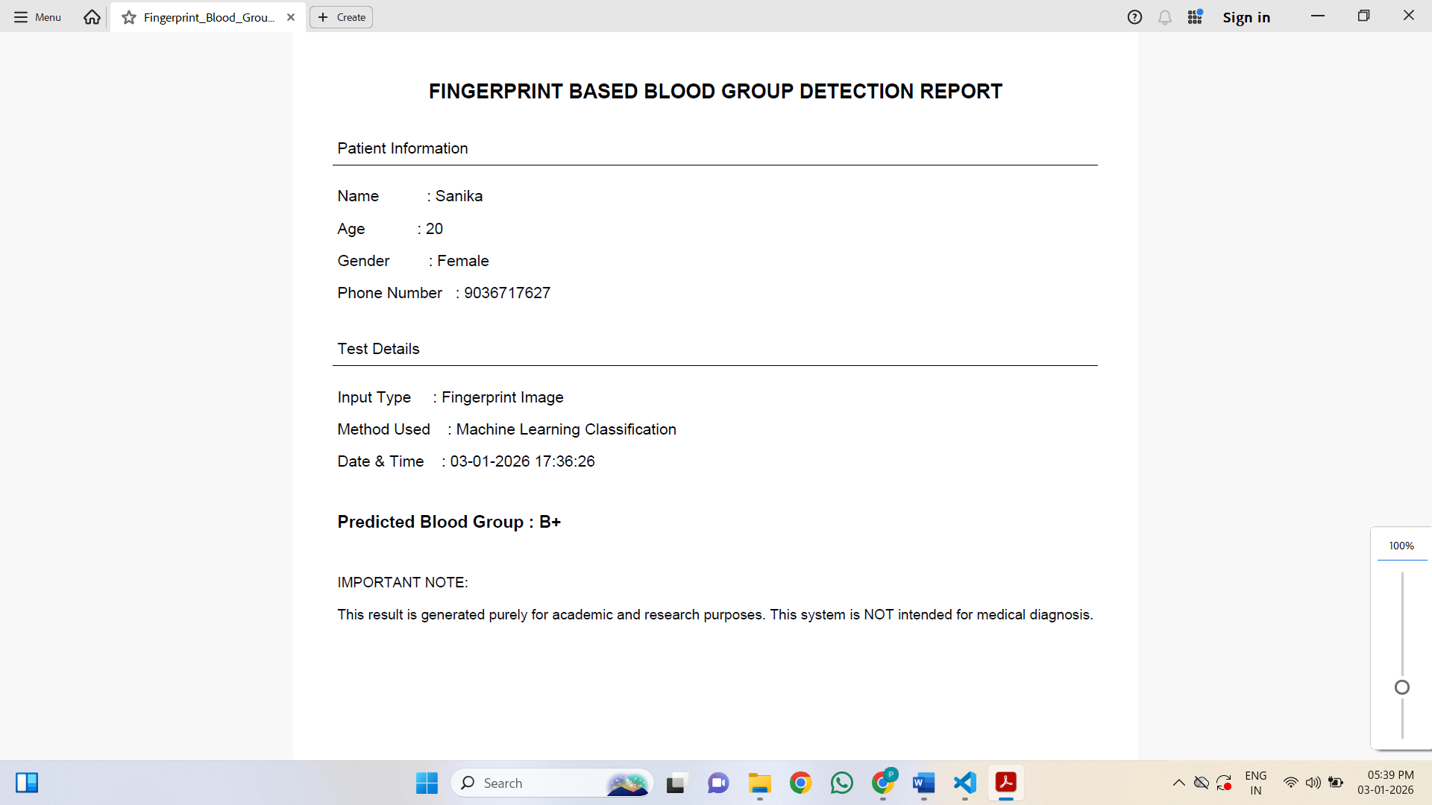

Slide 27
Conclusion and Future Scope
Conclusion:
The Non-Invasive Blood Group Detection Using Fingerprints project successfully demonstrates the feasibility of using fingerprint biometrics combined with machine learning techniques for blood group identification. The system provides a fast, reliable, and non-invasive alternative to traditional blood typing methods, which typically require blood samples and laboratory analysis. By extracting meaningful fingerprint features such as ridge density, curvature, and texture patterns and applying classifiers like Random Forest or Support Vector Machine, the system is able to predict blood groups effectively without physical intervention.

Slide 28
Conclusion and Future Scope
Future Scope:
  The system can be further improved to provide more accurate and reliable blood group prediction by expanding the fingerprint dataset with greater diversity and higher-quality images.
  Advanced machine learning techniques and hybrid models can be explored to enhance classification performance and reduce prediction bias across different blood groups.
  The system can be extended for use in emergency situations, rural healthcare centers, and mobile medical units, where quick and non-invasive blood group identification is essential.

Slide 29
References
[1]H. S. Vineela, “MACHINE LEARNING-BASED BLOOD GROUP DETECTION: A
Review” International Journal of Research, vol. 13, no. 5, pp. 129- 135, 2024.
[2]T Nihar K. Yeshwanth, and K. Prabhakar, “Blood Group Prediction Using Fingerprint Images with CNN and Gabor Filter ”International Journal of Research, vol. 13, no. 5, pp. 122- 128, 2024.
[3]T. Gupta, “Blood Group Prediction Using Deep Learning”, International Journal of Advanced Research in Computer Science, vol. 15, no. 2, pp. 45- 50, 2024.
[4]P1 S. Swathi, Sushmitha, and Prof. Kavita, “Fingerprint Based Blood Group Prediction Using Deep Learning”, International Journal of Research, vol. 13, no. 5, pp. 136- 142,2024.
[5]Gupta, A., agarwal , S,., &Jain, R., et al. Investigates the use of machine learning algorithms, including Support vector Machines(SVM} and random forests(RF),for blood group identification using fingerprint images.(2023)

Slide 30
References
[6] Verma, A., & Bhatt, V., et al. Provides n overview of automated blood group identification methods based on fingerprint nalysis and the use of machine learning algorithms.(Feb 11,2022).
[7] Vijaykumar Patil N, D. R. Ingle. A Novel approach to predict blood group using fingerprint map reading and the use of HFDU06 Scanner. (Apr 02-04,2021).
[8] M. Mondal, M. Katun, U. K. Suma, and Md. R. Islam, “Blood group identification based on fingerprint by using 2D Discrete wavelet and binary transform,”modeling, measurement and control C, vol.80, no.2, pp.63-70,2019.
[9] H. AIshehri, M. Hussain, H. AboAISamh, Q. Emad-ul-Haq, and A. M. Azmi, “Alignment-free cross-sensor fingerprint matching based on the Co-Occurrence of ridge Orientations and Gabor-HoG Descriptor”.
[10] Dr. D. Shiva Sundhara Raj and J Abinaya”A Cost-effective method for blood group detection using fingerprints”, International journal of advance study and research work, vol.2, march 2019.

Slide 31
Publication Status
The project titled “Non-Invasive Blood Group Detection Using Fingerprint Images” presents an innovative approach, and a patent application related to this work has been filed. The application is currently under review by the Indian Patent Office (https://en.wikipedia.org/wiki/Indian_Patent_Office).

